Slide 1
“The Field of the ‘Photographable’”: From the Global North to the Global South and from the Global South to the Global North. Visual Approaches, Appropriation and Flows in Africa
Mobility patterns in small and intermediate towns and its implication on urban rural linkages – A focus on the milk value chain
Presentation by Jackson Kago
Doctorant, University of Bordeaux Montaigne, France
18 May 2021

Slide 2
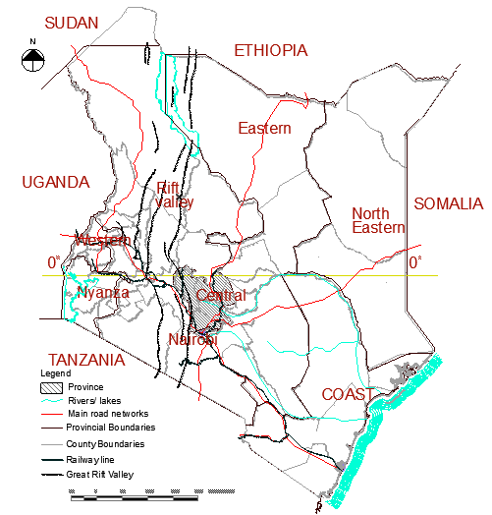
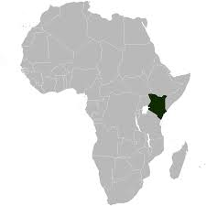
Introduction
Context –
Kenya

Slide 3
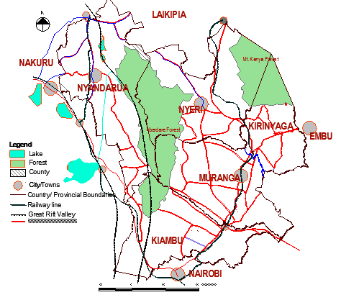
Study area
The study looks at the dynamics of mobility along the milk value chain from production, collection, processing, and distribution of milk. The research area is a 47 kilometer transect between Ruiru (25 kilometers from Nairobi) to Uplands village centre.

Slide 4
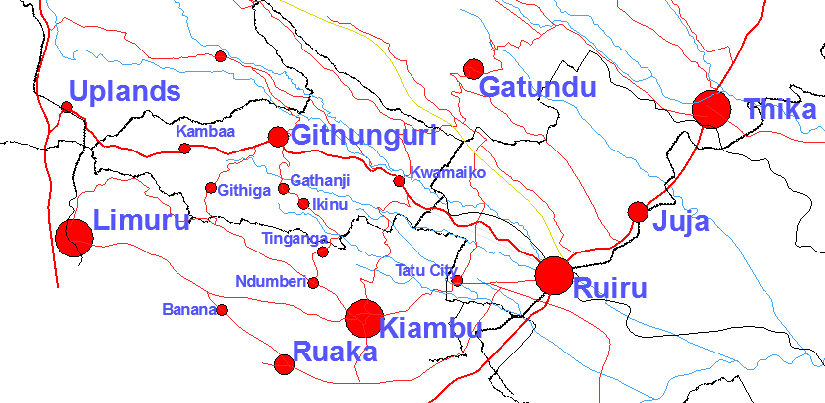
The transect

Slide 5
Study Objectives and research questions
Research Objectives | Research Questions
Assess the mobility patterns – People and goods. | What are the mobility patterns between small and intermediate towns and the surrounding region?
Assess the influence of infrastructure on mobility patterns | How has infrastructure influenced mobility in these Towns and surrounding regions?
Assess the impact the mobility patterns have on livelihoods | What is the impact of mobility on rural and urban livelihoods transformation?
Assess the impact of the mobility patterns on rural and urban linkages | What is the impact of mobility patterns on urban-rural linkages?

Slide 6
Tools for Photographic Research and their Uses
The study utilizes photos acquired from google street view and those taken during field work.
Google street view was useful in providing an exploratory overview of the various activities taking place along the transect.
These photographs depict the movements relating to and affecting mobility along the milk value chain.
The limitations of google street view is that it’s not able to show the time variations of mobility, since they are taken at a specific time, and are also limited to major access roads
There was need to supplement google street view with photos taken during field work.

Slide 7
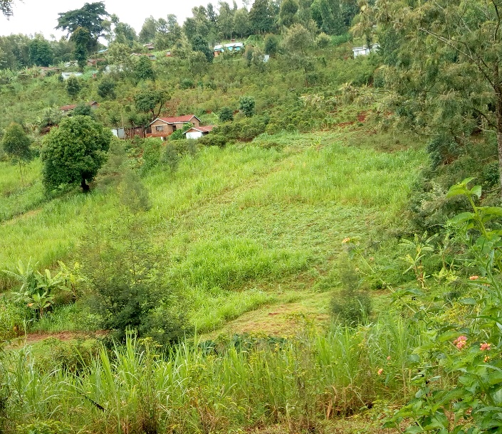
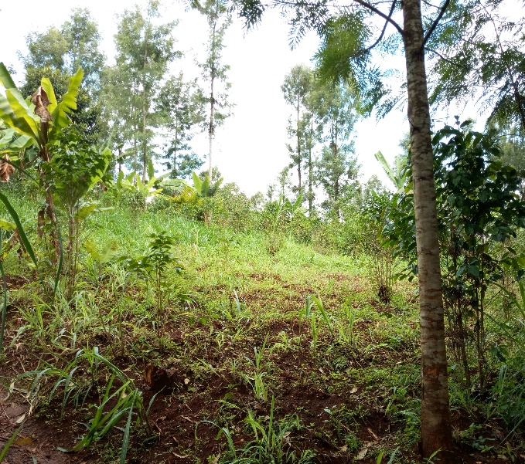
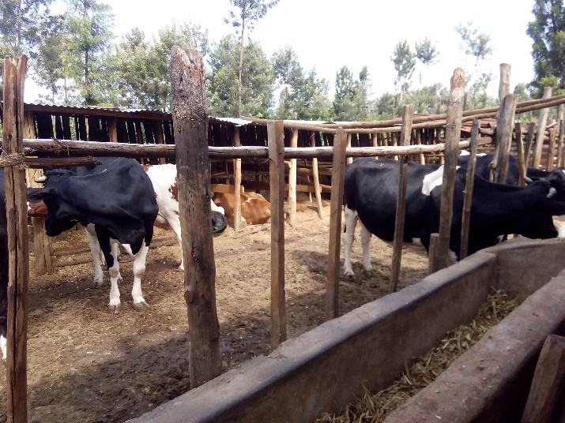
Background - Land use
Increasing population has led to reduction of farm sizes
The smallholders farmers.
Source, Jackson KAGO, 2019
The dairy farmers in the study area practice zero grazing, where animals are enclosed in a structure, and the farmers are mobile
Source, Jackson KAGO, 2019
Diversification from coffee farming to other farming activities including dairy farming. The photo shows neglected coffee trees intercropped with napier grass
Source, Jackson KAGO, 2019

Slide 8
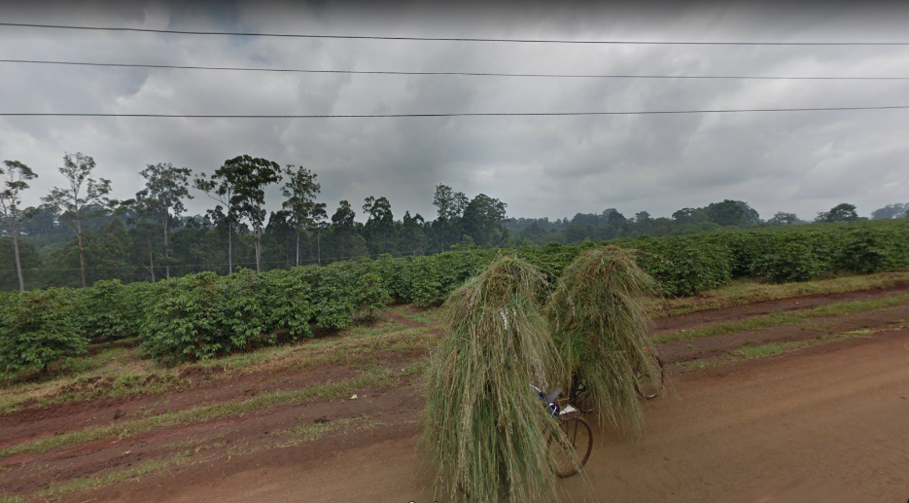
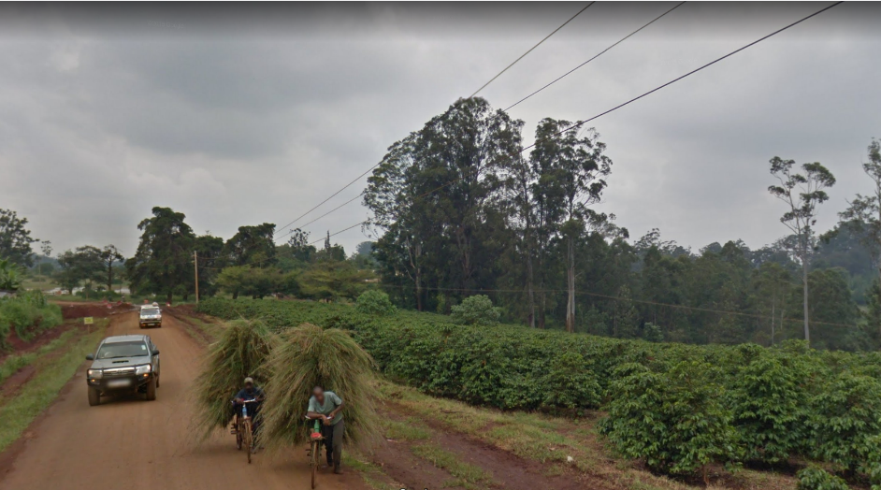
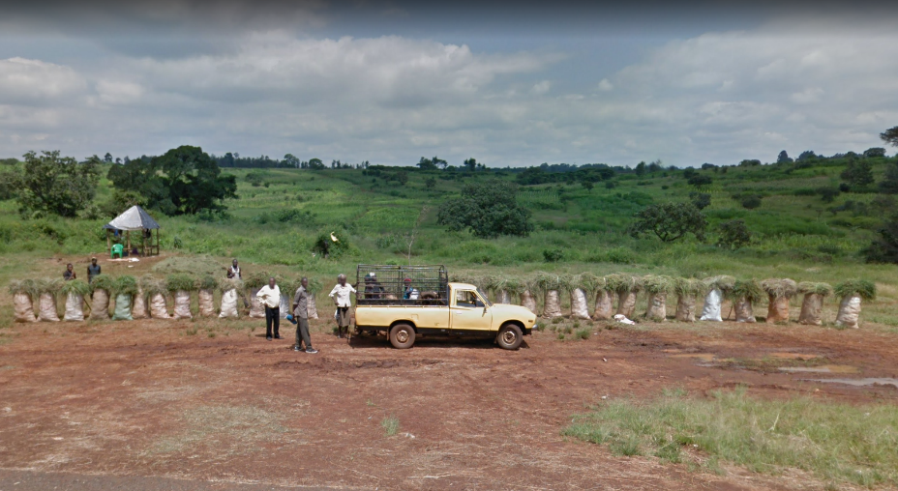
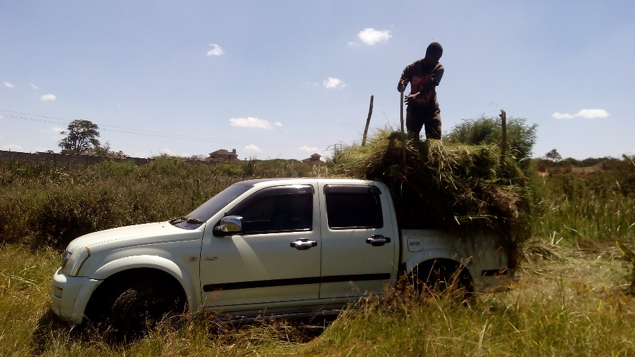
Milk production
Milk production necessitates the mobility
The small holder farmers get grass from parcels of land in between the large coffee farms on the lower parts of the transect.
Source, Google Street view, 2018
A farmer buying grass from casuals who cut it from farms previously used to grow coffee along Kigumo road.
Source, Google Street view , 2018
A farmer getting grass from the lower parts of the transect with a pick up.
Source, Jackson KAGO, 2019

Slide 9
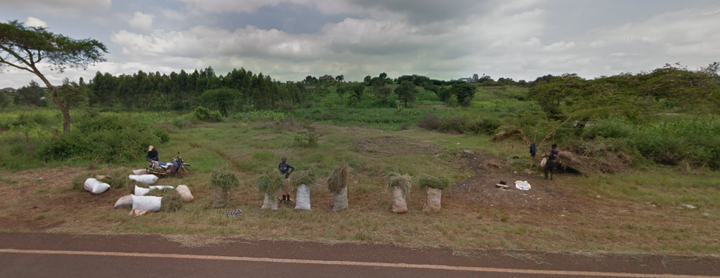
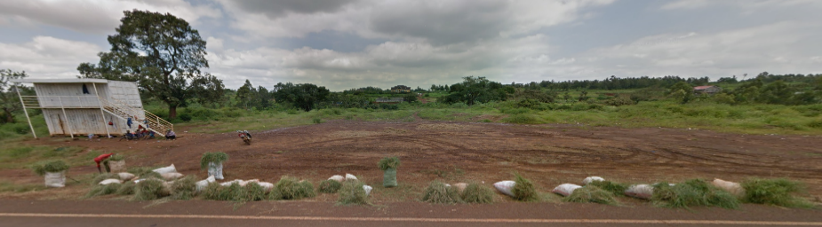
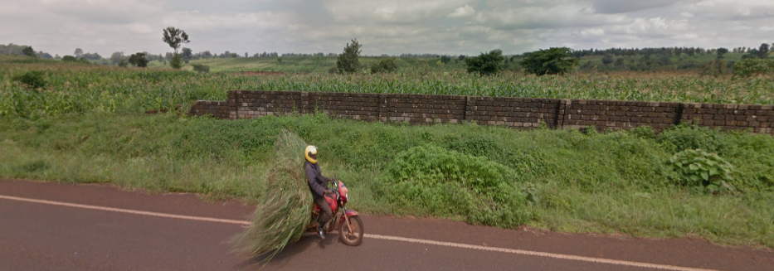
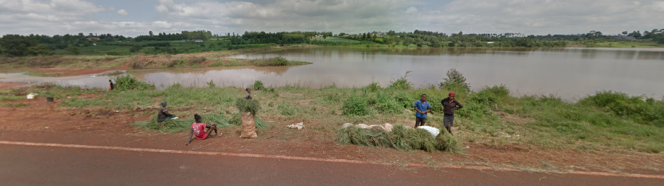
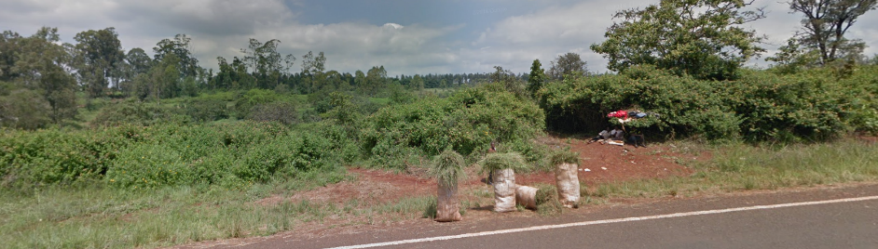
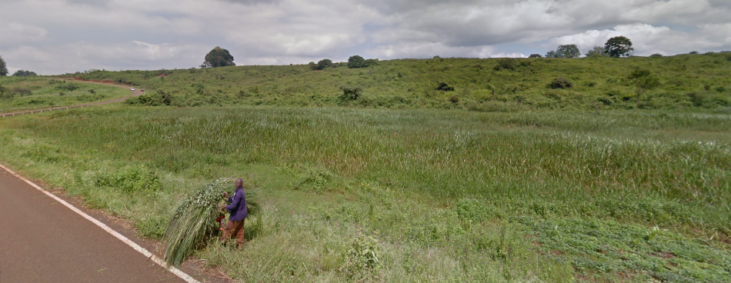
Milk production
With Google street view I was able to locate activities relating to transportation of grass along the transect and get an idea of where these activities were taking place and their frequency along the transect.
One sack is sold for about Ksh. 200 (About 2 Euros)
Source, Google Street view , 2018

Slide 10
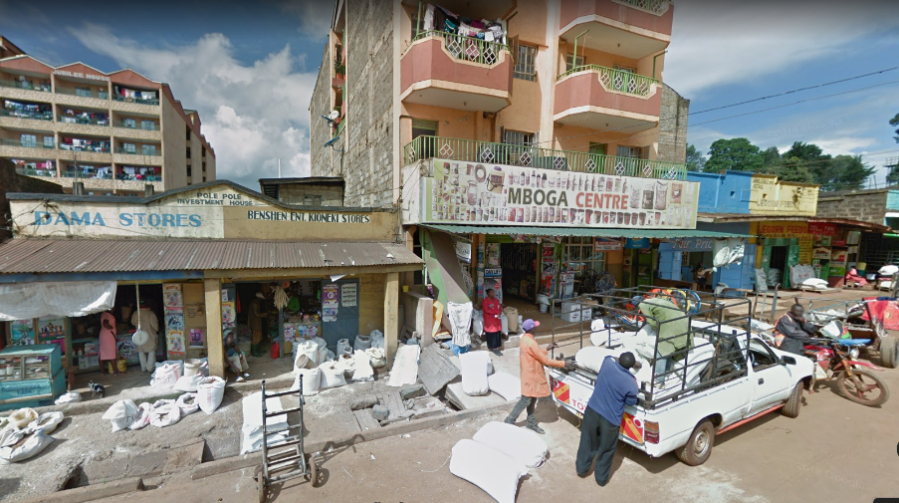
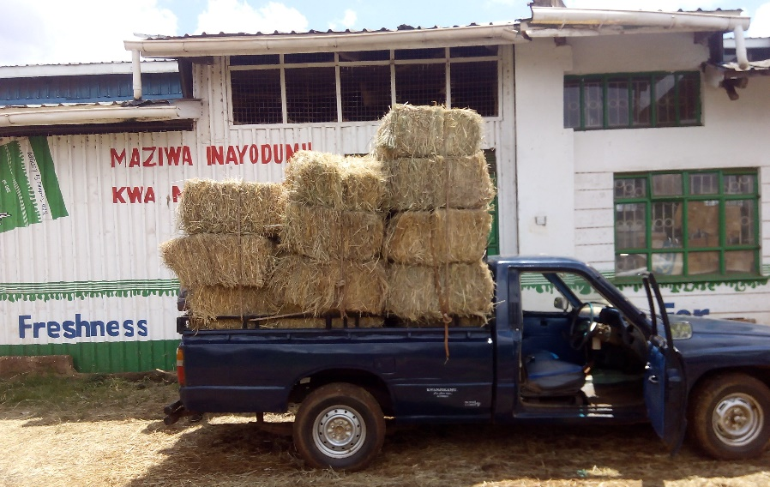
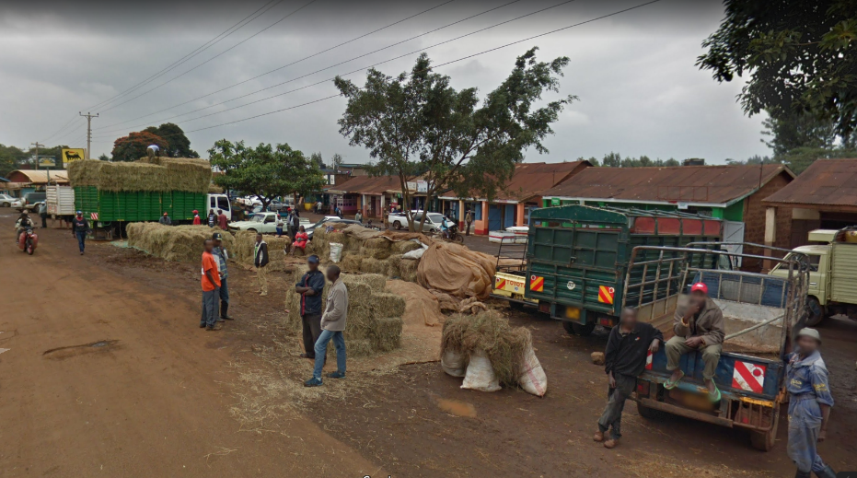
Milk production
Use of commercial feeds to supplement the forages grown in the farmlands.
Sold at the small towns and village centres.
The photo one of the streets in Githunguri town whose business activities are oriented towards milk production.
Source, Google Street view, 2018
A farmer getting hay on loan from the Githunguri Dairy Farmers Cooperative Society Ltd.
Source, Jackson KAGO, 2019
Sale of hay at the road side at Kwamaiko village centre along the transect.
Source, Google Street view , 2018

Slide 11
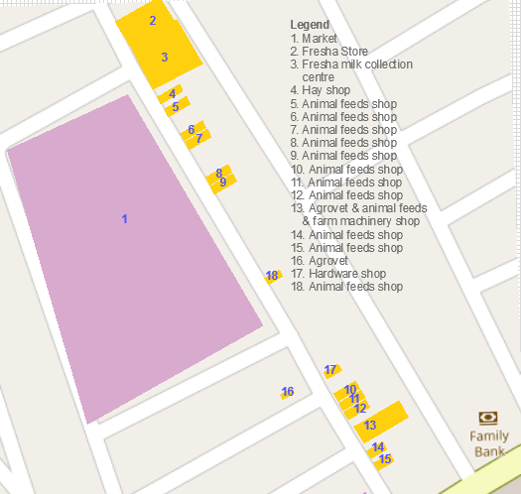
Market Street Githunguri Town
With google street view I was able to locate 18 business activities dealing directly with milk production along one street in Githunguri town.
Source, Jackson KAGO adapted from Google Maps, 2019

Slide 12
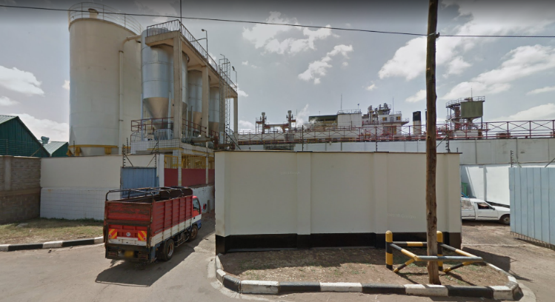
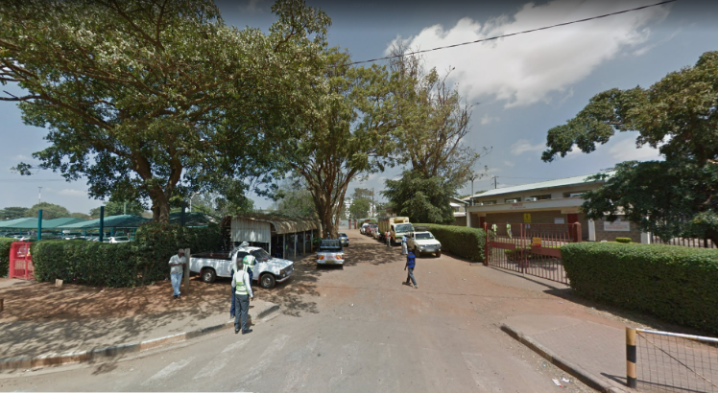
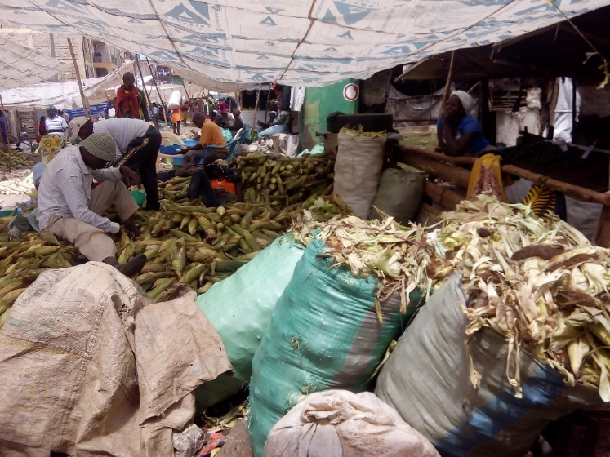
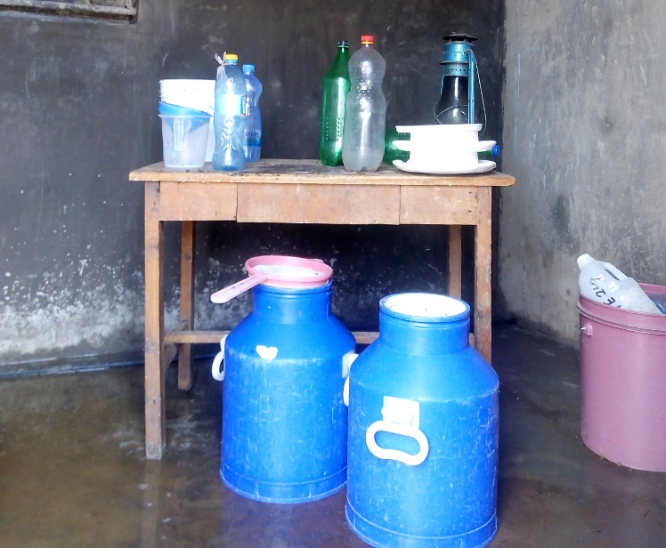
Milk production
Waste from markets and industries are a source of feeds for dairy cattle. Kenya Breweries Ltd sells to farmers brewers waste (spent grains) locally known as Machicha.
The photo show a lorry waiting to get the waste from the factory and other pick up vans waiting for their turn
Source, Google Street view, 2018
Githurai market is one of the largest food markets located at the periphery of Nairobi. It stocks produce from the agricultural rich Mt. Kenya Highlands, and is strategically located along Thika road.
A kiosk located at the edge of an urban plot for sale of milk.
Source, Jackson KAGO, 2019

Slide 13
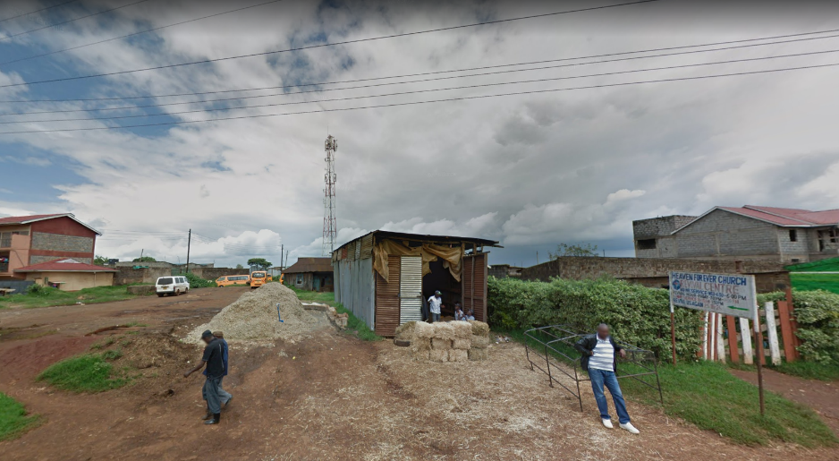
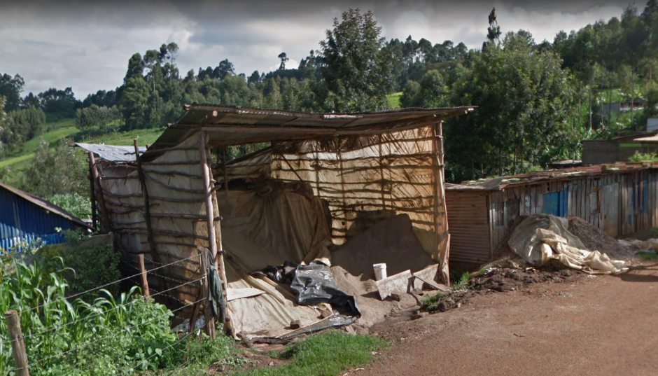
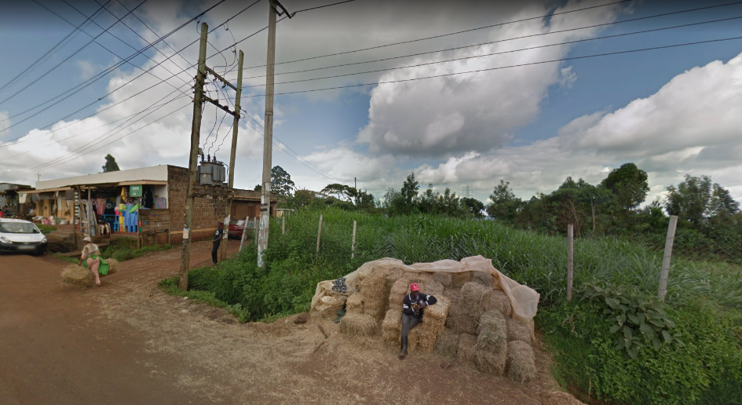
Milk production
Pulp waste from the processing of pineapples in Thika town is also one of the feeds that farmers use.
This is a photo of pineapple pulp being sold at the side of the road near Githunguri town. The vendor also stocks hay.
Source, Google Street view, 2018
Sale of chicken waste along the road in the town centres.
Source, Google Street view , 2018
Sale of hay at the roadside in Githiga village centre.
Source, Google Street view , 2018

Slide 14
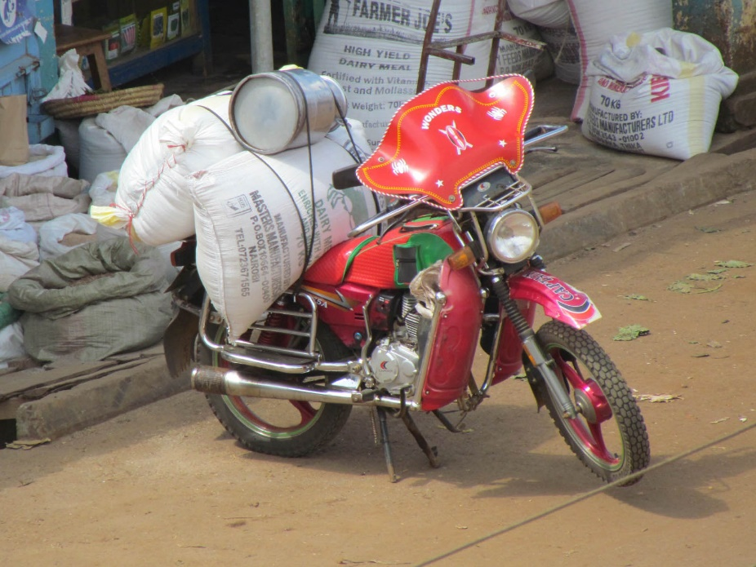
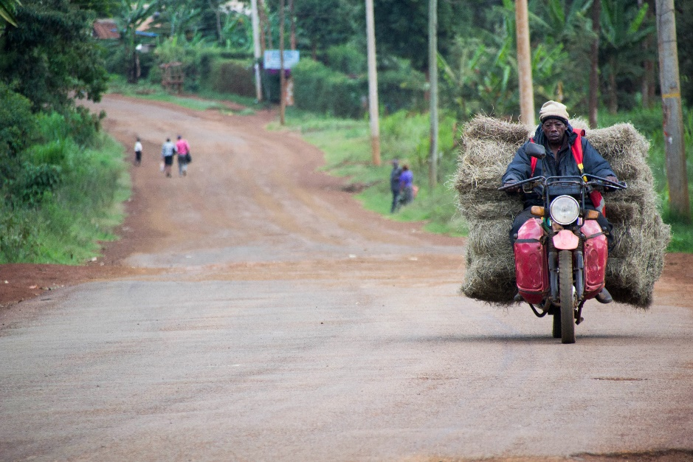
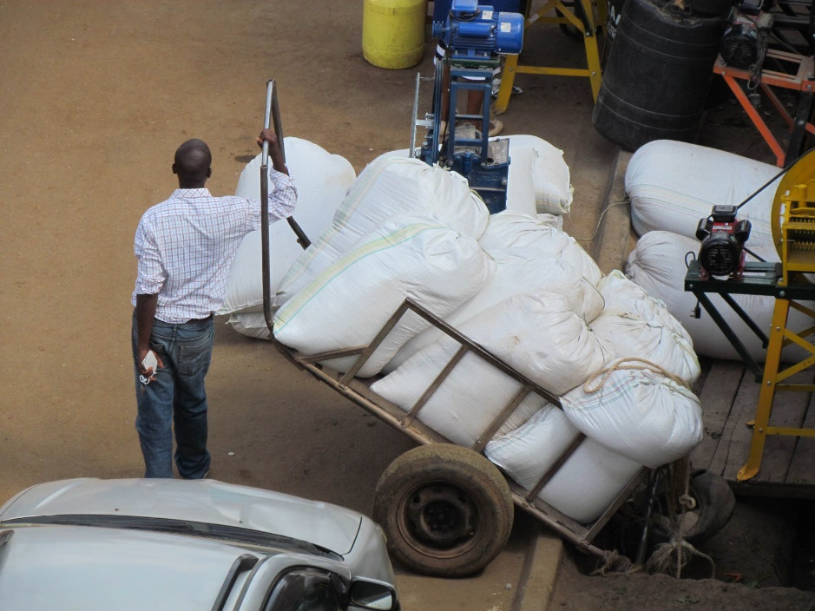
Milk production
Various modes of transportation are used to transport animal feeds
Use of the motorbike has gained popularity.
Farmers can call the motor bike (boda boda) transporter and request them to ferry animal feeds, while they make payment to the seller through mobile money transfer (Mpesa).
Source, Jackson KAGO, 2019

Slide 15
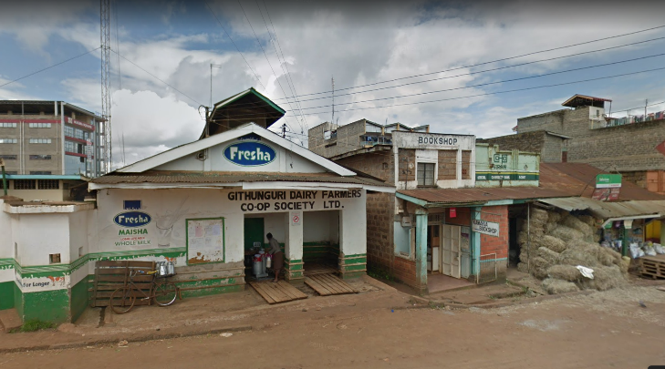
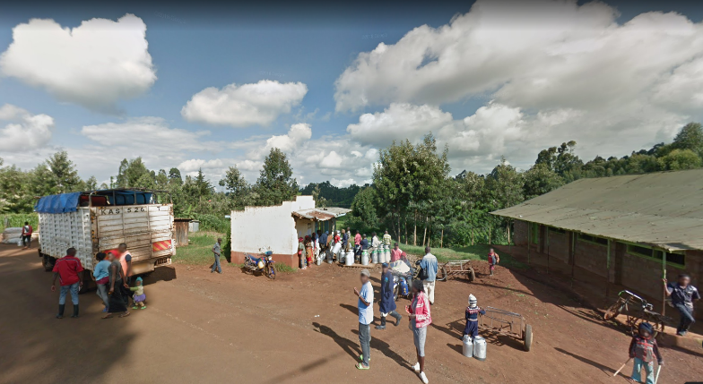
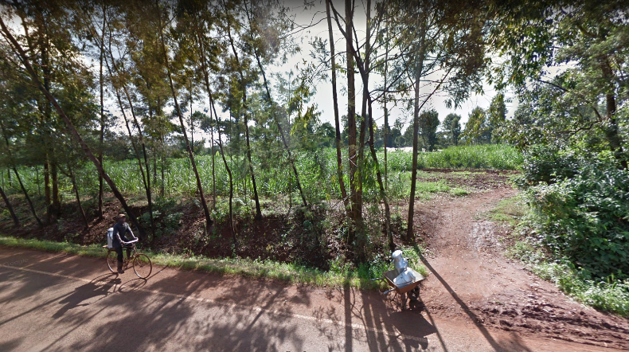
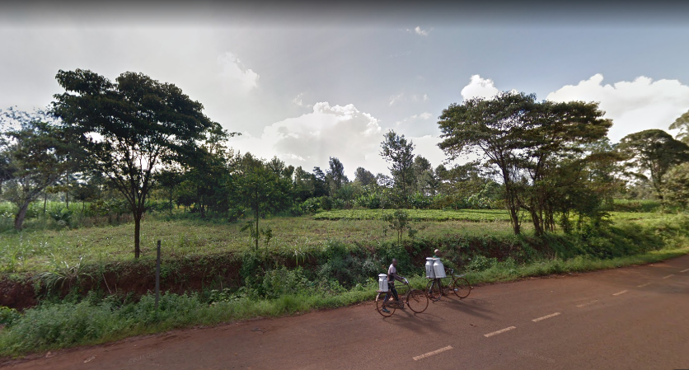
Milk Collection
Non-motorized modes of transportation since the milk collection centres are located within a kilometer radius.
This is a photo of Githunguri town milk collection centre.
Source, Google Street view, 2018
Matuguta Milk Collection Centre.
.
Source, Google Street view, 2018
Farmers transporting milk to the collection centre
.
Source, Google Street view, 2018
Farmers transporting milk to the collection centre
.
Source, Google Street view, 2018

Slide 16
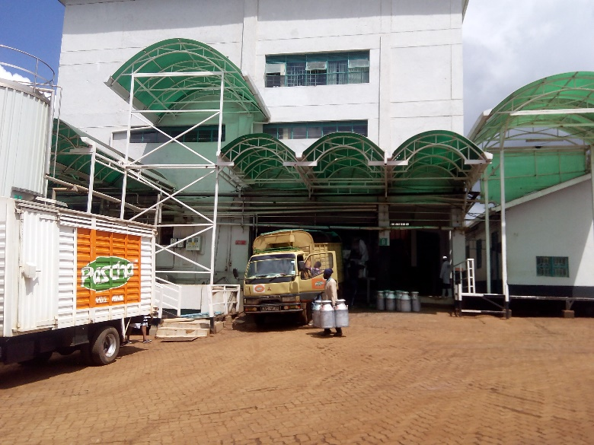
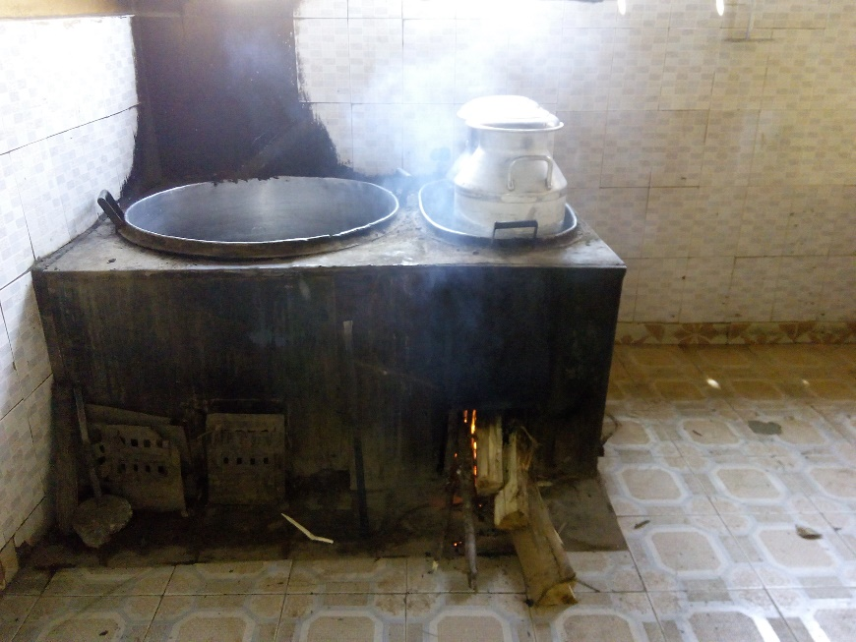
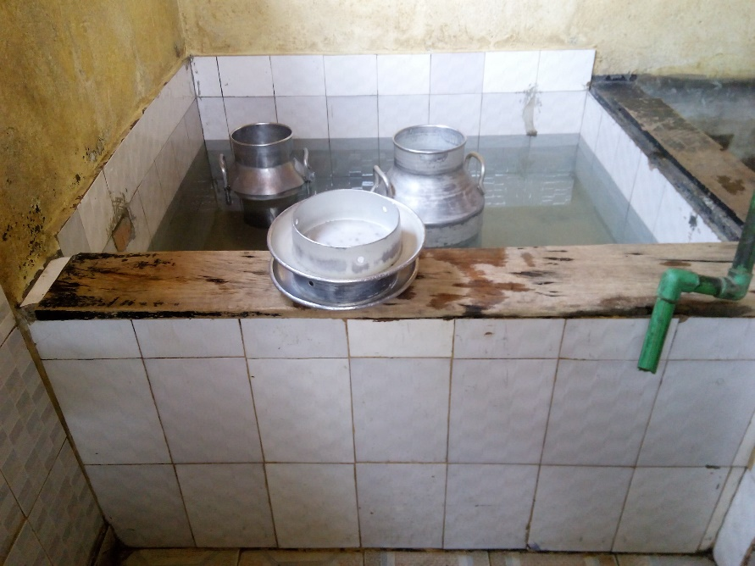
Milk Processing
Milk processing is done by licensed cottage and large private or public co-operative owned processors. This is a photo of Pascha Uplands Premium Dairies & Foods Ltd a private processing company located in Kagwe, near Githunguri.
Source, Jackson KAGO, 2019
These are photos of a cottage milk processing business located 1 kilometer from Githunguri town. The owner uses firewood to pasteurize the milk.
He sells his milk at two outlets in Githunguri and Kiambu town where he operates a Milk Dispensing Machine.
The farmer gets 70 % of the milk from his dairy farming business, and the rest from a milk cooperative. He also operates a general shop in Githunguri town alongside the milk parlour.
Source, Jackson KAGO, 2019

Slide 17
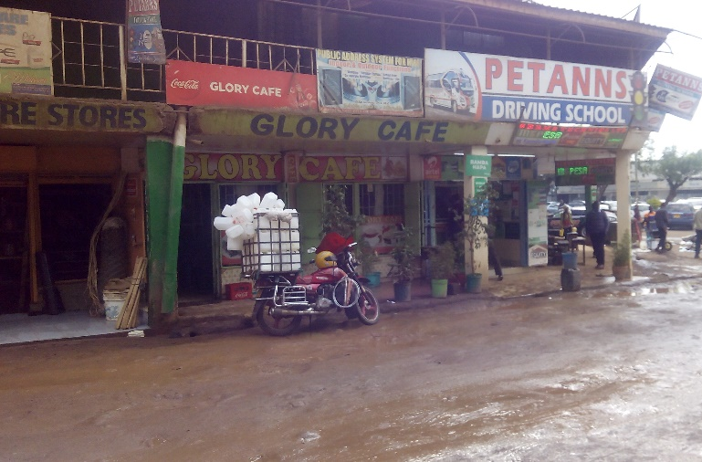
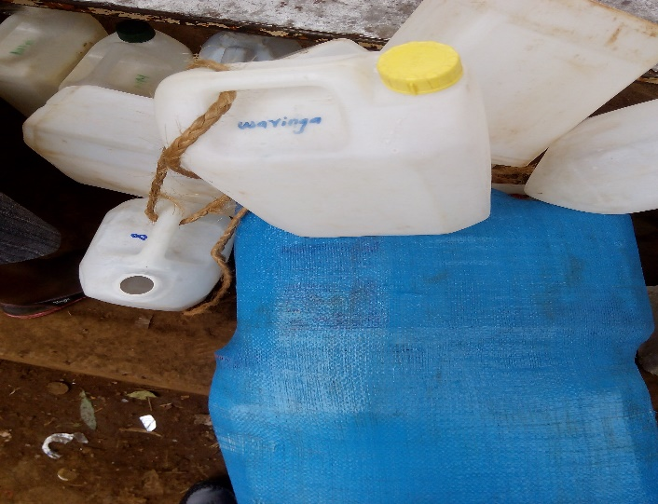
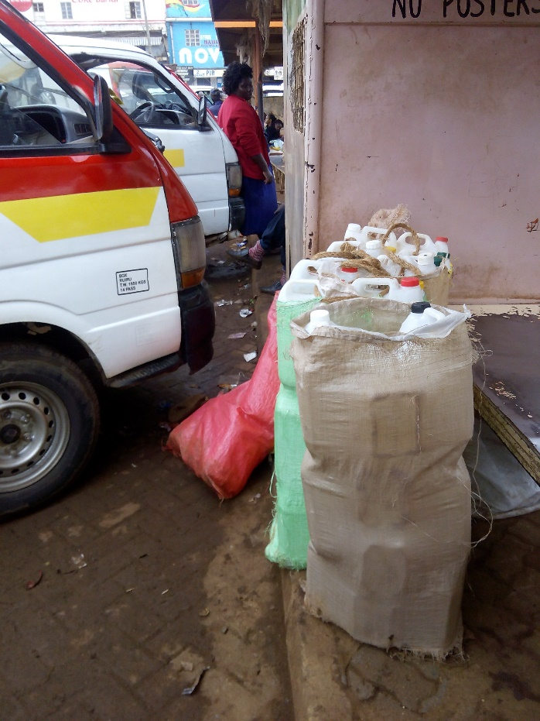
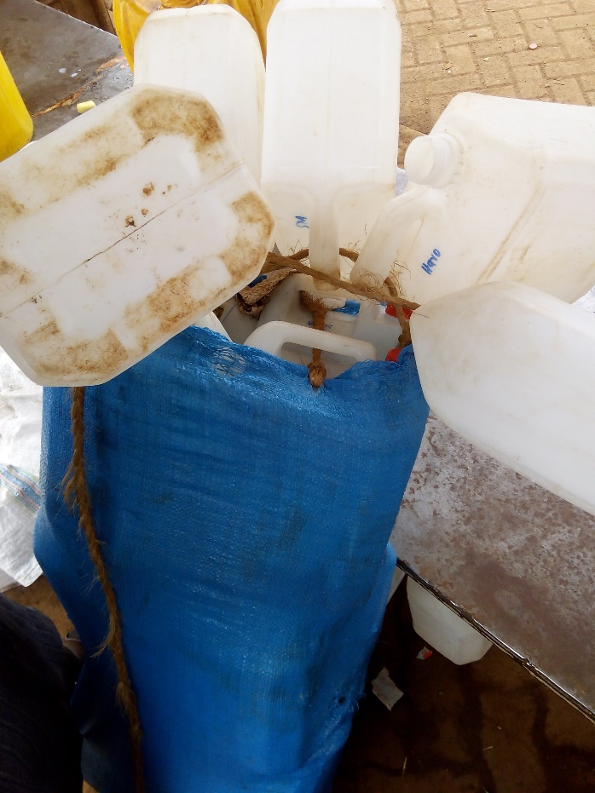
Milk Distribution
Formal milk processing factories is through licensed companies.
Informal milk distribution is by the milk vendors who sell raw milk to hotels, general shops or directly to customers.
Source, Jackson KAGO, 2018
Bodaboda/ motorbike parked outside a restaurant where he delivers milk
Source, Jackson KAGO, 2018
Milk jerrycans ready for transportation with Public Transport. Each jerrycans is marked to trace the owner
Source, Jackson KAGO, 2019

Slide 18
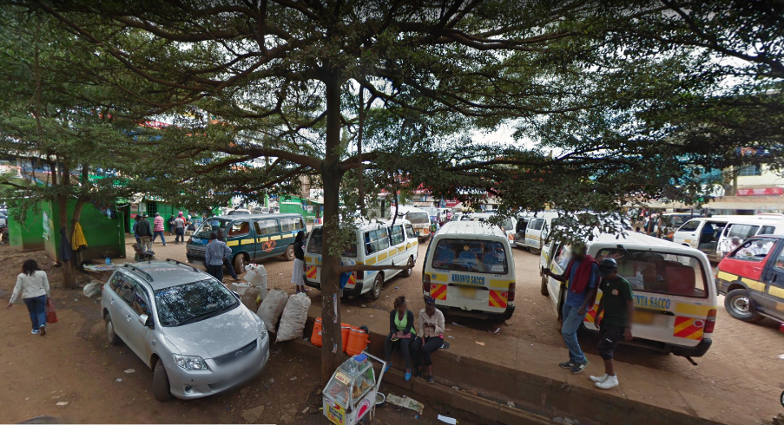
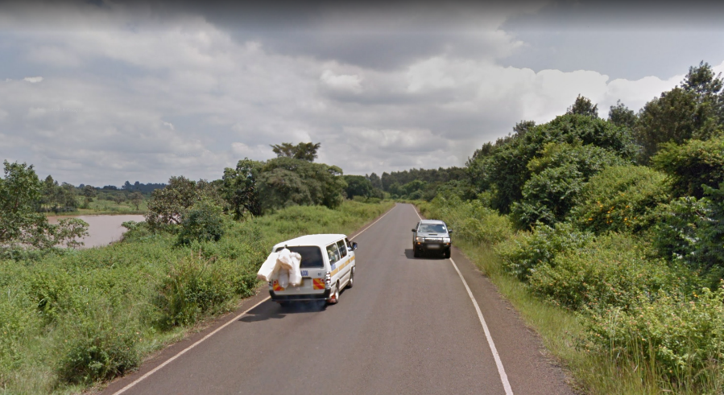
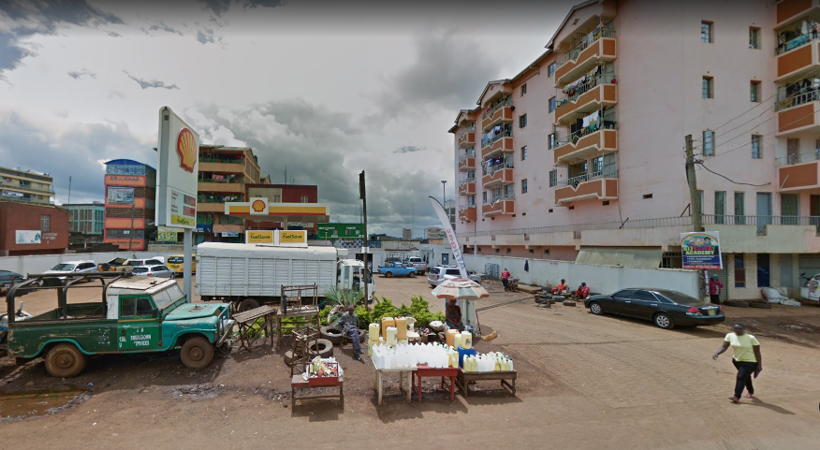
Milk Distribution
Raw milk is also transported by matatu vans, a mode preferred by the female vendors who are not able to use the motorbike transport. Source, Google Street view, 2018
A street vendor selling jerrycans in Githunguri town.
Source, Google Street view, 2018

Slide 19
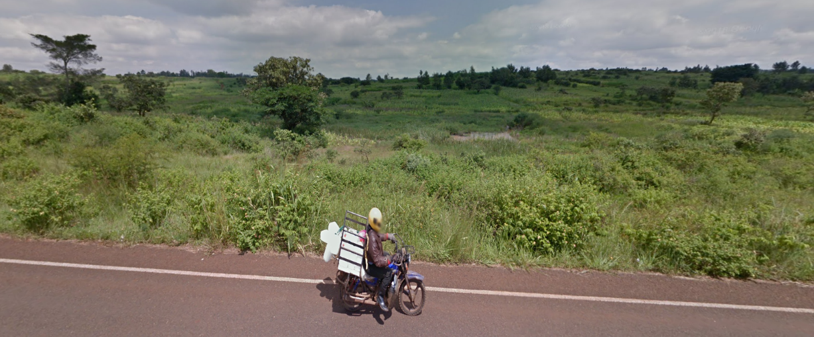
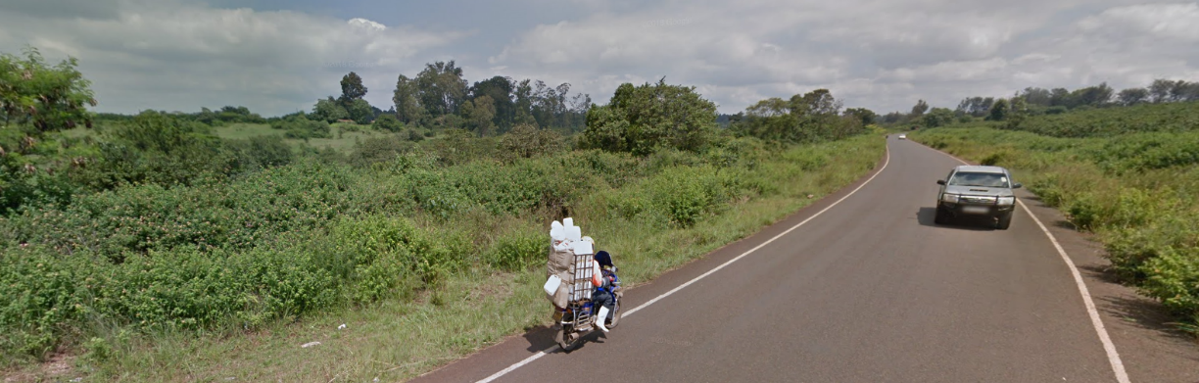
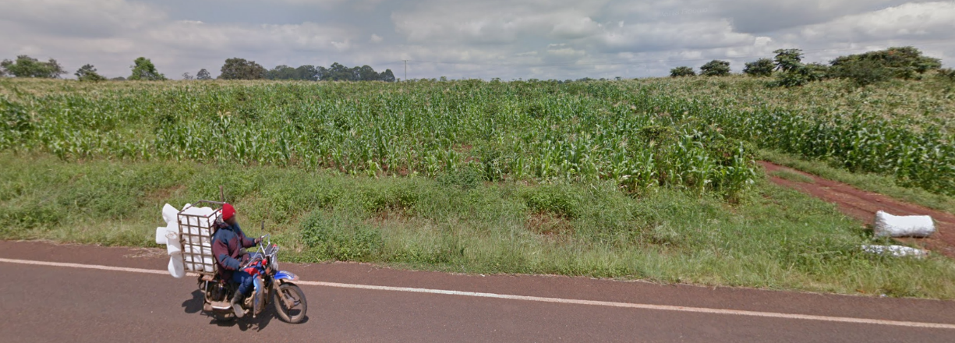
Milk Distribution
Through google street view, I was able to get an idea of the prevalent routes used by the milk vendors, and the direction of movement from Ruiru town to the rural areas. The photos could have been taken mid-morning when the vendors were returning home.
Source, Google Street view, 2018

Slide 20
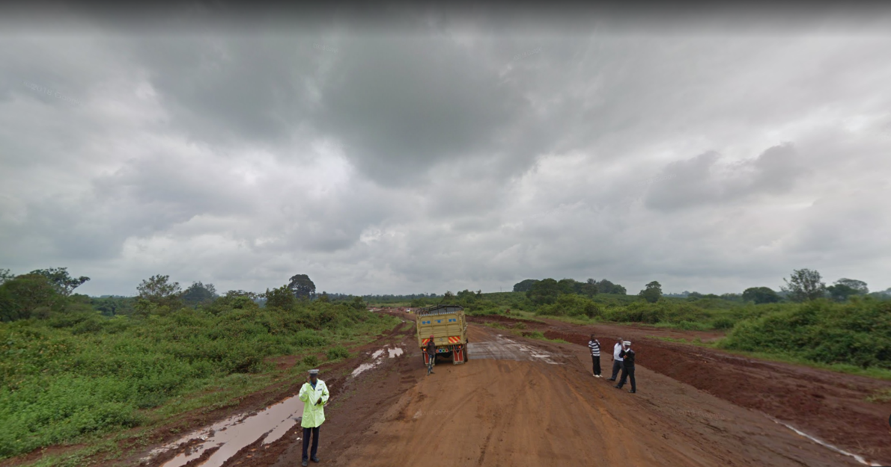
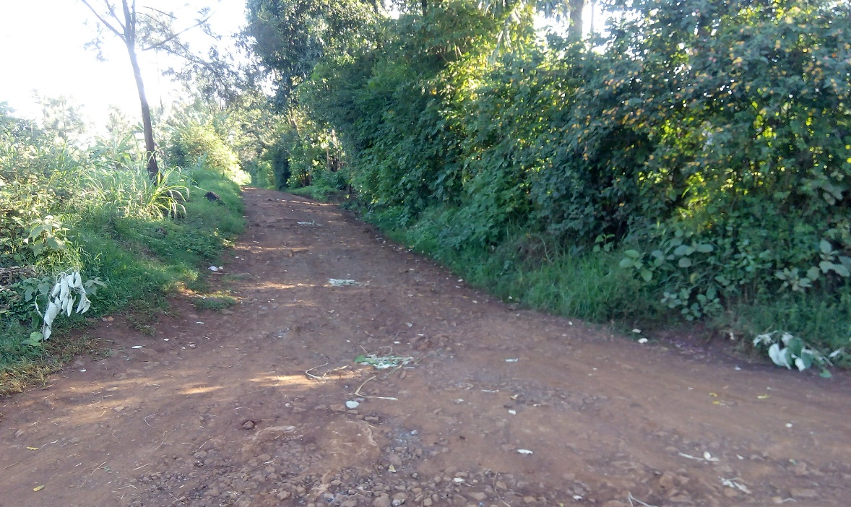
Barriers and Adaptations to Mobility
Various barriers exist in the mobility of milk along the transect including difficult terrain, bad road condition, police, unreliability of some modes of transport, affordability among others.
Actors in the milk value chain have made some adaptations to overcome some of these barriers.
Source, Google Street view, 2018
Police check along the Ruiru - Githunguri road
Source, Google Street view, 2018
Disguised signage of cut twigs to direct a veterinary doctor to a homestead
Source, Jackson KAGO, 2019

Slide 21
Conclusion
There are limitations of google street view is that it’s not able to show the time variations of mobility, since they are taken at a specific time, and are also limited to major access roads
There is need to supplement google street view with photos taken during field work.

Slide 22
Thank You for your attention!

